Slide 1
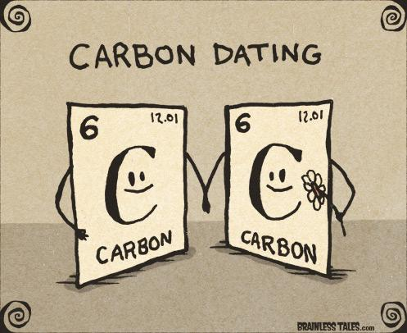
Carbon Dating
Amabel Jeon, L Tran,
Nihar Mahajan, Raveeha Mahmood

Slide 2
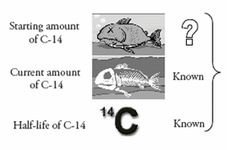
Research Question:
How does differentiation in carbon dating help determine the age of organic materials?

Slide 3
Rationale
The world will be filled of garbage and litter in the future. It is important to be aware of the time it will take for the organic materials to decay so we know the importance of the conservation of energy.
Scientists can use the knowledge from carbon dating to predict and observe energy cycles in the environment.
All the members have been in chemistry and are aware of this method. Since we all are interested in the subject, we decided to investigate it further

Slide 4
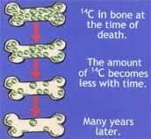
What is Carbon Dating?
Used to estimate the age of organic materials like wood and leather.
For organisms, can only be used to determine age of organism since death.
Three natural isotopes: C12, C13, and C14. C-12 is the most common and stable, but C-14 is more unstable and radioactive. Thus C-14 decays.
Notes:
There are three principal isotopes of carbon which occur naturally - C12, C13 (both stable) and C14 (unstable or radioactive). These isotopes are present in the following amounts C12 - 98.89%, C13 - 1.11% and C14 - 0.00000000010%. Thus, one carbon 12 atom exists in nature for every 1,000,000,000,000 C12 atoms in living material. The radiocarbon method is based on the rate of decay of the radioactive or unstable carbon isotope 14 (14C), which is formed in the upper atmosphere through the effect of cosmic ray neutrons upon nitrogen 14.
Carbon-14 dating is a way of determining the age of certain archeological artifacts of a biological origin up to about 50,000 years old. It is used in dating things such as bone, cloth, wood and plant fibers that were created in the relatively recent past by human activities.

Slide 5
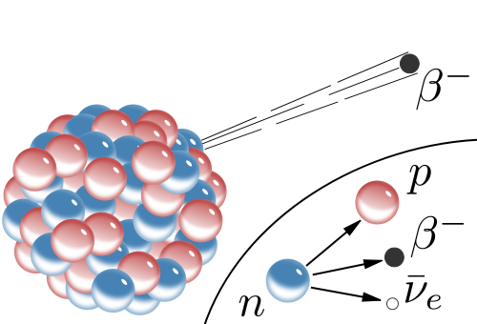
Explanation of Beta Decay
Occurs when an beta particle is emitted from an atomic nucleus
When carbon-14 decays into nitrogen-14, an electron antineutrino is emitted. This shows an increased atomic number but unchanged mass number.

Slide 6
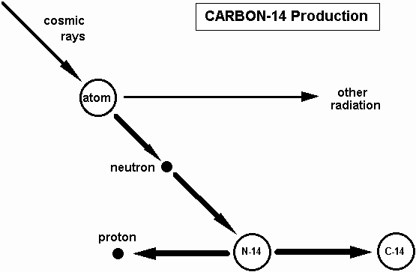

Slide 7
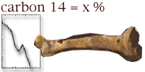
Implementation of Half-Life
Libby Half-life
The time required for the decay of the Carbon-14 isotope is about 5730 years.
In the atmosphere, C-14 atoms can also form when neutrons strike nitrogen atoms to knock off a proton.
Once the animal stops obtaining C-14 from surroundings, carbon dating begins as C-14 decays at half-life

Slide 8
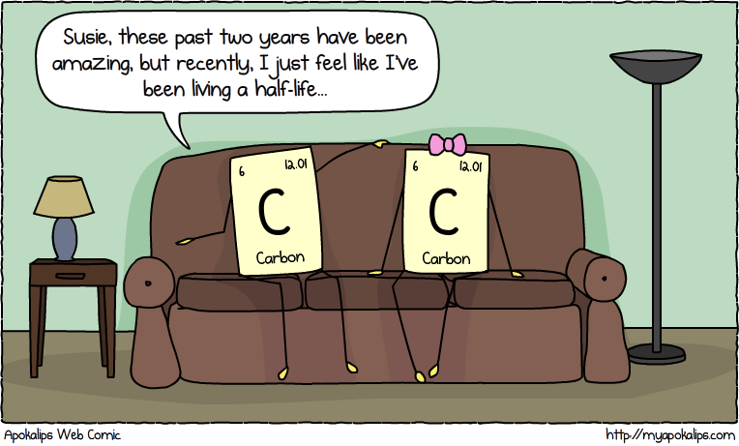

Slide 9
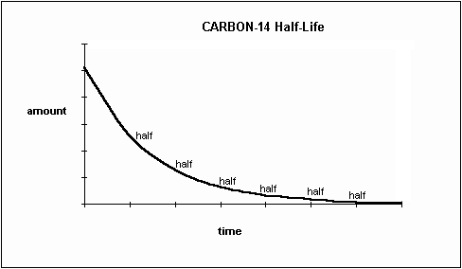
Interactive Simulation
Demonstration of Libby Half-Life
Give everyone a number between 1-30 (how many people are in class)
Start with all 30 people on one side. This represents a fresh carcass.
Commence with half life. As years go by, start by dividing odds/evens. Then keep dividing by two to see how the C-14 ratio depletes. Make a tally of the number of years that pass.
Once last person is there, explain how half-life ends (since atoms cannot divide.

Slide 10
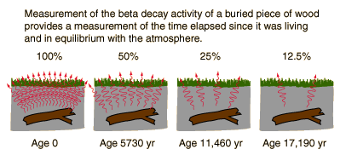
Use of Derivatives
R = percentage amount of carbon-14
t = time (years)
k = constant
Initial half-life : 5730 years

Slide 11
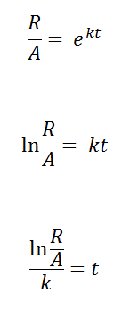
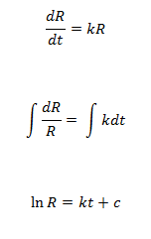
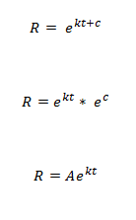
Use of Derivatives (cont.)

Slide 12
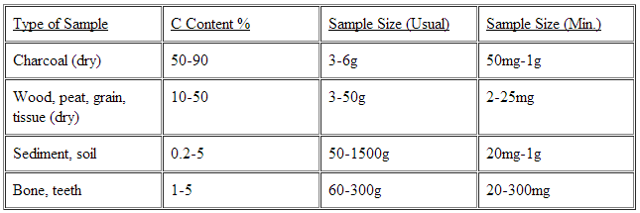
Carbon Content of Organic Materials
“If dinosaur bones are 65 million years old, there should not be one atom of C-14 left in them.” (Fischer)

Slide 13
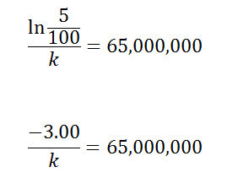
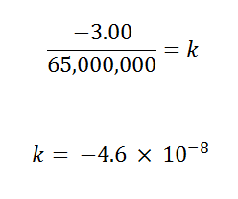
Mathematical Process

Slide 14
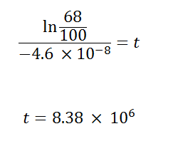
Example - Amount of carbon : 68%

Slide 15
Theoretical Equations
N or R= % of carbon-14 in sample
N0 or A= % of carbon-14 in original
T = time
-0.693 = rate of decay
t1/2 = half-life

Slide 16
Limitations
Unfortunately, this experiment requires lots of high-tech equipment, so we cannot conduct this investigation in real life to gain necessary raw data.
We are forced to rely on theoretical evidence
We do not know the absolute measurement of C14 but only a relative one

Slide 17
Extensions
This experiment can be extended by observing the carbon-decay in living organisms rather than dead ones.
Perhaps, other radioactive decay can be observed and be applied to derivatives

Slide 18
Works Cited
"Carbon 14 Dating." Math Central. University of Regina, n.d. Web. 09 June 2014.
Dragovitsch, Peter, and Ben A. Fusaro. "Separable Differential Equations."Separable Differential Equations. N.p., 2000. Web. 05 June 2014.
Fischer, John M. "Carbon-14 Dating Dinosaur Bones."Newgeology.us. N.p., n.d. Web. 09 June 2014.
"Radio-Carbon Dating." Radio-Carbon Dating. N.p., n.d. Web. 09 June 2014.
"Radiocarbon Dating." Radiocarbon WebInfo. University of Oxford, n.d. Web. 09 June 2014.
"Separable Differential Equations." Separable Differential Equations. N.p., n.d. Web. 09 June 2014.

