Slide 1
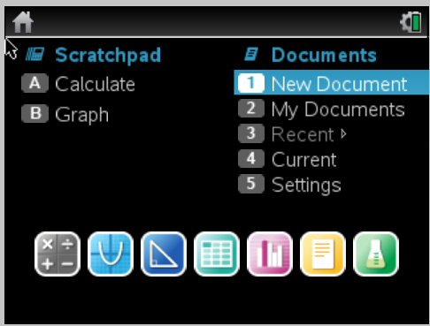
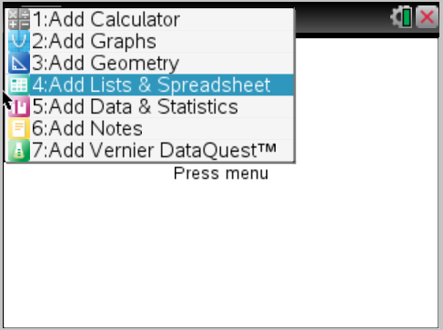
Calculators Out!
Please turn on the calculator and open a new document, adding a list/spreadsheet page:

Slide 2
Here our bivariate data to plot: The Turkey Problem
Tom raises turkeys. He records the weight, y, measured in pounds, of one of his turkeys over several months, x.
x | y
2 | 7
5 | 9
8 | 18
11 | 17
14 | 24

Slide 3
Calculator Instructions,Plotting Data:
TI-nspire
TI-83/84
New Document
Add Lists & Spreadsheets
Label columns “months” and “weight”
Enter the data
Add a new page (ctrl doc)
Add Data & Statistics
Make x months and y weight
STAT
edit
Enter the months in L1
Enter weight in L2
Open STAT PLOT (2nd y=)
Select 1: Plot 1
Select On
Verify Xlist: L1 and Ylist:L2
ZOOM - ZoomStat
Graph

Slide 4
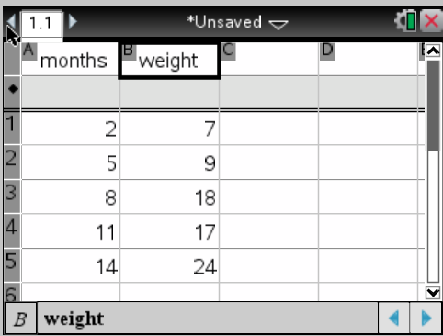
Plotting Data:
TI-nspire
New Document
Add Lists & Spreadsheets
Label columns “months” and “weight”
Enter the data
Add a new page (ctrl doc)
Add Data & Statistics
Make x months and y weight

Slide 5
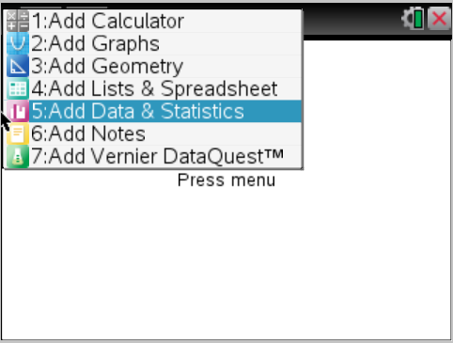
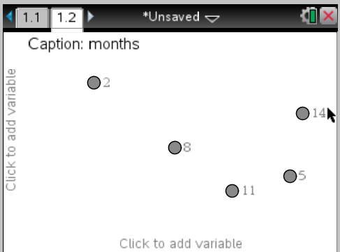
Plotting Data:
TI-nspire
New Document
Add Lists & Spreadsheets
Label columns “months” and “weight”
Enter the data
Add a new page (ctrl doc)
Add Data & Statistics
Make x months and y weight

Slide 6
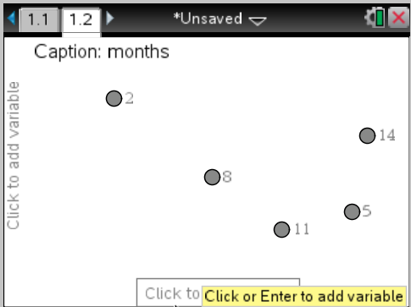
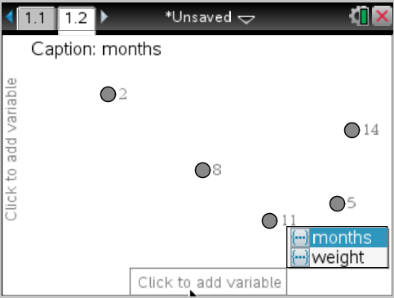
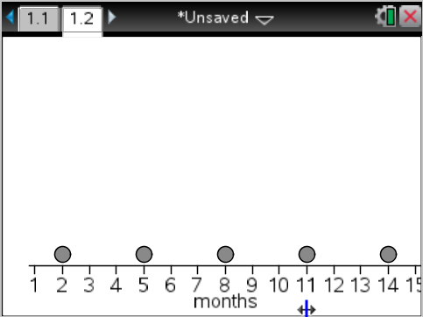
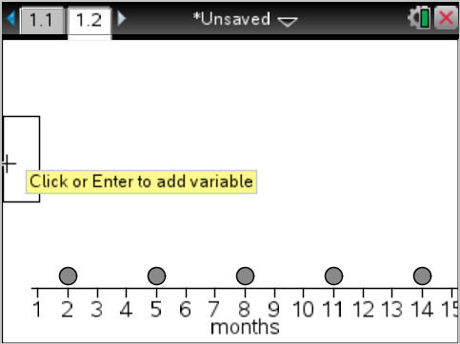
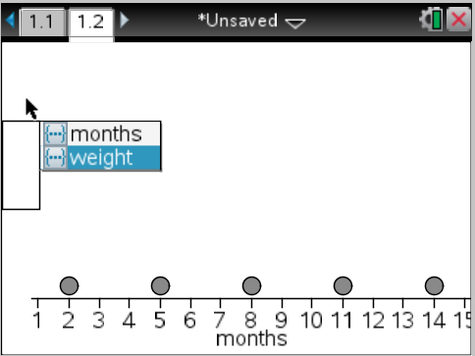
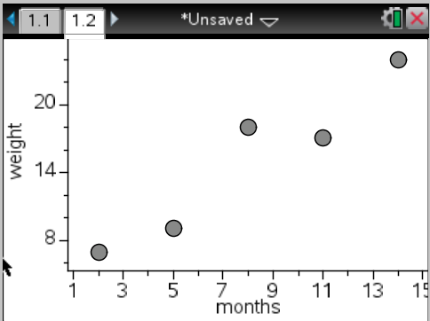
TI-nspire
New Document
Add Lists & Spreadsheets
Label columns “months” and “weight”
Enter the data
Add a new page (ctrl doc)
Add Data & Statistics
Make x months and y weight

Slide 7
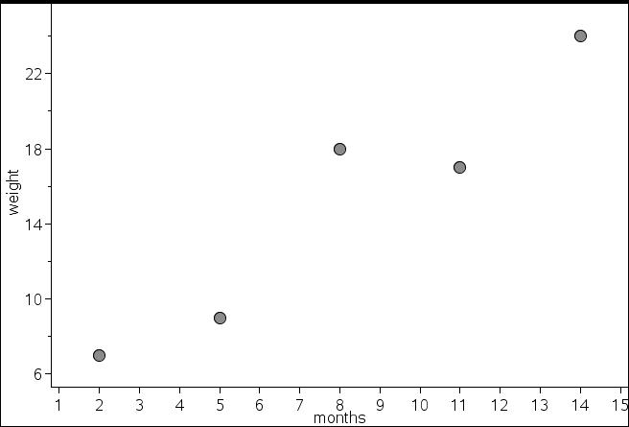
Here’s our Scatter Plot ☺

Slide 8
Running a Linear Regression:
TI-nspire
TI-83/84
Menu
Analyze
Regression
Show linear
STAT
CALC
LinReg(ax+b)
Calculate & Press Enter
Y=
VARS
Statistics
EQ
RegEq
Graph

Slide 9
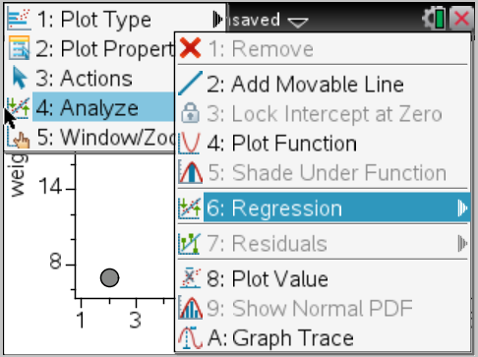
Running a Linear Regression:
TI-nspire
Menu
Analyze
Regression
Show linear

Slide 10
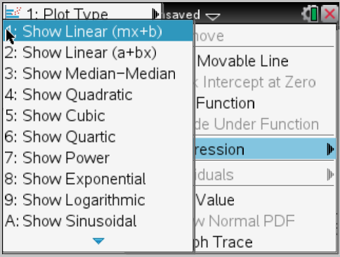
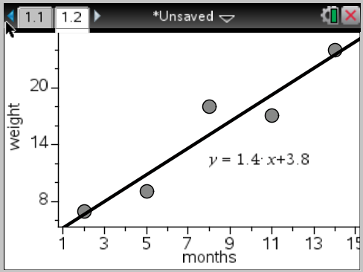
Running a Linear Regression:
TI-nspire
Menu
Analyze
Regression
Show linear

Slide 11
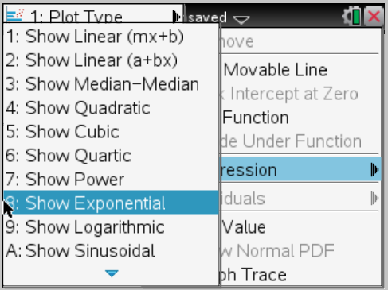
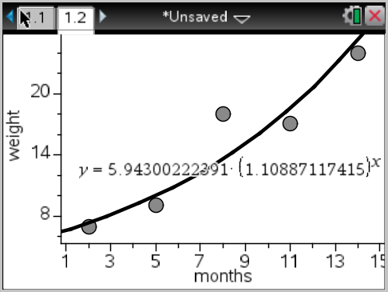
Running a Non- Linear Regression:
TI-nspire
Menu
Analyze
Regression
Show ___________
(let’s try exponential)

Slide 12
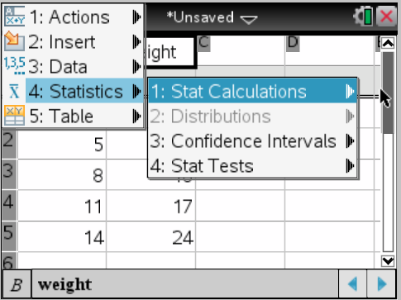
Running a Regression in the Spreadsheet page:
TI-nspire
In the list/spreadsheet page
Menu, Statistics, Stat Calc.
________ Regression
Choose your columns for the x-list (months) and y-list (weight)
Results are in the next column (unless you choose a different one) also provides the correlation coefficient “r” and “r-squared”

Slide 13
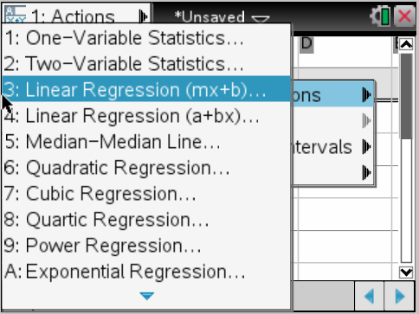
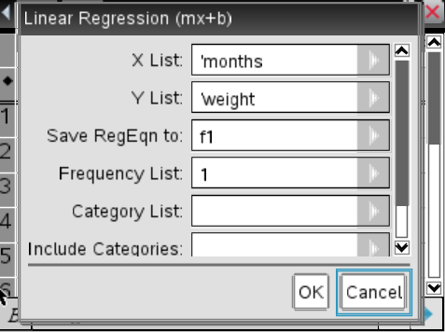
Running a Regression in the Spreadsheet page:
TI-nspire
In the list/spreadsheet page
Menu, Statistics, Stat Calc.
________ Regression (I did a linear regression)
Choose your columns for the x-list (months) and y-list (weight)
Results are in the next column (unless you choose a different one) also provides the correlation coefficient “r” and “r-squared”

Slide 14
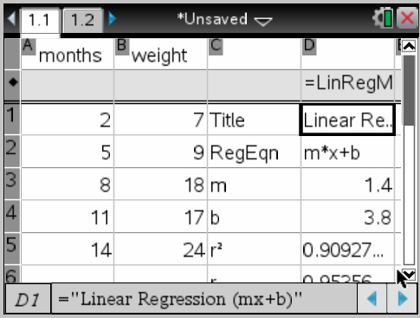
Running a Regression in the Spreadsheet page:
TI-nspire
In the list/spreadsheet page
Menu, Statistics, Stat Calc.
________ Regression (I did a linear regression)
Choose your columns for the x-list (months) and y-list (weight)
Results are in the next column (unless you choose a different one) also provides the correlation coefficient “r” and “r-squared”

Slide 15
Turkey Problem What is the correlation coefficient? Which type of regression is the best fit for this data? How do you compare different regressions?

