Slide 1
Modeling 21A Correlation

Slide 2
Correlation refers to the relationship or association between two variables.
Characteristics to consider:
Direction
Linearity
Strength
Outliers
Causation

Slide 3
Direction
Positive
Negative
No Correlation

Slide 4
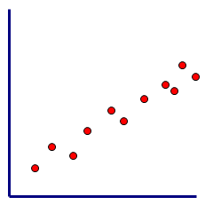
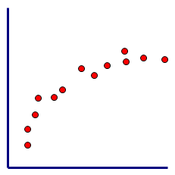
Linearity
Linear
Non-Linear

Slide 5
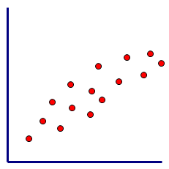
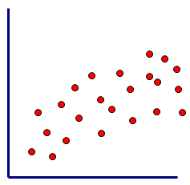
Strength
Strong
Moderate
Weak

Slide 6
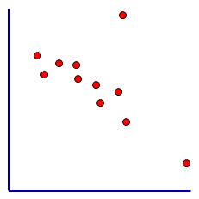
Outliers
An outlier is an isolated point which does not follow the trend formed by the main body of data.
Outlier
Not an outlier

Slide 7
Causation
Ex 1: The arm length and running speed of a sample of young children were measured, and a strong, positive correlation was found to exist between the variables.
Does this mean that short arms cause a reduction in running speed?
No! The strong, positive correlation is attributed to the fact that arm length and running speed are both related to a third variable, age.

Slide 8
Causation
Ex 2: The number of TVs sold and the number of stray dogs collected in a small town were recorded over several years and a strong positive correlation was found between the variables.
Does this mean that TVs cause dogs to run away?
No! Both variables happen to have been increasing over the same period of time.

Slide 9
Causation
Ex 3: The age of an athlete and distance that athlete can throw a discus have a strong, positive correlation.
Does this mean that an increase in age causes an increase in throwing distance?
Yes! These variables have a causal relationship: a change in one variable causes a change in the other variable.

Slide 10
Check-up
Draw a scatter plot that shows a moderate, negative correlation.
Add an outlier to your scatter plot.
Homework: Modeling 21A (1 – 4)

